Slide 1
SALARY AND COMPENSATION ANALYSIS THROUGH EXCEL DATA MODELING
NAME :NAYEEMUNNISHA.A
REG.NO :122204686
DEPARTMENT:BCOM(CORPORATE SECREATRYSHIP
COLLEGE :VALLAL PT.LEE CHENGALVARAYA NAICKERARTS AND SCIENCE COLLEGE

Slide 2
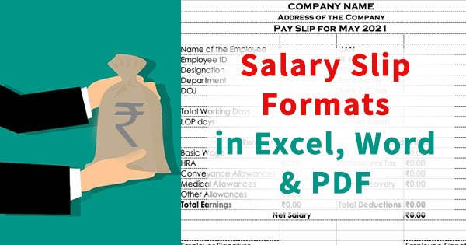

Slide 3
AGENDA
SALARY
DEARNESS ALLOWANCE(DA)
EMPLOYEES STATE INSURANCE SCHEME
PROVIDENT FUND
ADVANCE
OVER TIME
TABLE OF SHOWING SALRY SLIP
SHOWING SALARY CHART

Slide 4
SALARY
a fixed amount of money agreed every year as payfor an employee usually paid directly into his or her bank account every month

Slide 5
Dearness Allowance (DA)
the cost-of-living adjustment allowance that the government provides to both current and retired members of the public sector. It is determined using the government employee basic salary percentage.

Slide 6
Employees State Insurance Scheme
The ESI or Employees State Insurance Scheme is an insurance cover provided to workers to aid them in uncertain and challenging times. It is a contributory fund governed by the Employee State Insurance Corporation and comes under the ESI Act, 1948.

Slide 7
Provident Fund (PF)
Provident Fund (PF) is a retirement benefits scheme for salaried professionals designed to provide them with enough funds after retirement.

Slide 8
advance
Salary advances are short-term loans given to employees that are deducted later from future salaries. Some companies allow such advances. The advance amount is deducted from the net income at the end of the month and over the forthcoming months.

Slide 9
Net salary
Net salary, also known as take-home salary, is the amount of money that you will receive after all deductions. The deductions are made from the CTC and include things like income tax, Professional tax, Public Provident Fund (PPF), etc. Net salary is usually lower than the gross salary.

Slide 10
Overtime
Overtime pay is the rate of payment employees receive for working extra hours in addition to their regular working hours. is the rate of payment employees receive for working extra hours in addition to their regular working hours.

Slide 11
NAMES | BASIC SALARY | PER DAY | WORKING DAYS | WORKING DAYS AMOUNT | OVERTIME | OVERTIME DAY | OVERTIME AMOUNT | DA 10% | GROSS SALARY | ESI 15% | PF 12% | ADVANCE | NET SALARY
DHARSHINI | 15000 | 500 | 31 | 15500 | 100 | 3 | 300 | 1500 | 17300 | 2250 | 1800 | 500 | 12750
GAYATHRI | 15000 | 500 | 25 | 12500 | 100 | 5 | 500 | 1500 | 14500 | 2250 | 1800 | 0 | 10450
WFZY | 15000 | 500 | 20 | 10000 | 100 | 5 | 500 | 1500 | 12000 | 2250 | 1800 | 0 | 7950
IMXZ | 15000 | 500 | 21 | 10500 | 100 | 3 | 300 | 1500 | 12300 | 2250 | 1800 | 0 | 8250
MANJU | 15000 | 500 | 23 | 11500 | 100 | 2 | 200 | 1500 | 13200 | 2250 | 1800 | 5000 | 4150
BHARGAVI | 15000 | 500 | 28 | 14000 | 100 | 1 | 100 | 1500 | 15600 | 2250 | 1800 | 0 | 11550
SARAH | 15000 | 500 | 31 | 15500 | 100 | 4 | 400 | 1500 | 17400 | 2250 | 1800 | 0 | 13350
ANABELL | 15000 | 500 | 30 | 15000 | 100 | 8 | 800 | 1500 | 17300 | 2250 | 1800 | 0 | 13250
CONJURING | 15000 | 500 | 25 | 12500 | 100 | 7 | 700 | 1500 | 14700 | 2250 | 1800 | 0 | 10650
CRYSTAL | 15000 | 500 | 24 | 12000 | 100 | 5 | 500 | 1500 | 14000 | 2250 | 1800 | 0 | 9950
DAIMOND | 15000 | 500 | 26 | 13000 | 100 | 4 | 400 | 1500 | 14900 | 2250 | 1800 | 0 | 10850
MOMO | 15000 | 500 | 25 | 12500 | 100 | 9 | 900 | 1500 | 14900 | 2250 | 1800 | 0 | 10850
BROWNIE | 15000 | 500 | 24 | 12000 | 100 | 5 | 500 | 1500 | 14000 | 2250 | 1800 | 0 | 9950
JELLY | 15000 | 500 | 27 | 13500 | 100 | 4 | 400 | 1500 | 15400 | 2250 | 1800 | 0 | 11350
CHICKEN | 15000 | 500 | 27 | 13500 | 100 | 6 | 600 | 1500 | 15600 | 2250 | 1800 | 0 | 11550
NUGGETS | 15000 | 500 | 23 | 11500 | 100 | 1 | 100 | 1500 | 13100 | 2250 | 1800 | 0 | 9050
NOODLES | 15000 | 500 | 22 | 11000 | 100 | 2 | 200 | 1500 | 12700 | 2250 | 1800 | 0 | 8650
PEANUT | 15000 | 500 | 15 | 7500 | 100 | 3 | 300 | 1500 | 9300 | 2250 | 1800 | 0 | 5250
BUTTER | 15000 | 500 | 11 | 5500 | 100 | 4 | 400 | 1500 | 7400 | 2250 | 1800 | 0 | 3350
BREAD | 15000 | 500 | 28 | 14000 | 100 | 5 | 500 | 1500 | 16000 | 2250 | 1800 | 0 | 11950
ICE CREAM | 15000 | 500 | 29 | 14500 | 100 | 6 | 600 | 1500 | 16600 | 2250 | 1800 | 0 | 12550
JAM | 15000 | 500 | 30 | 15000 | 100 | 7 | 700 | 1500 | 17200 | 2250 | 1800 | 0 | 13150

Slide 12
SALARY CHART

